Slide 1


May ^{26th} 2024
Paris AI Hackathon
API Track
Tribe PARI

Slide 2
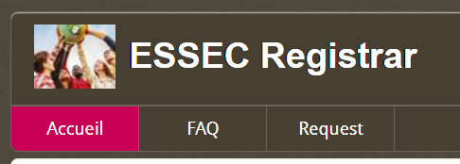
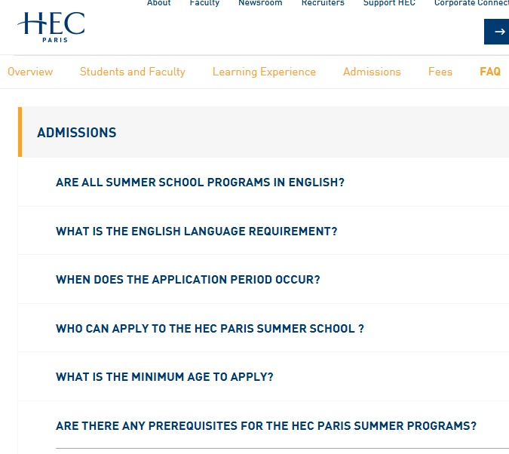
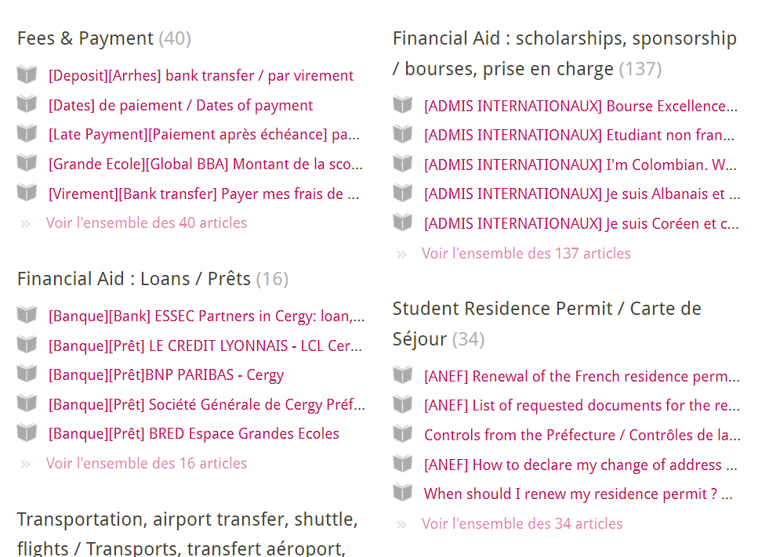

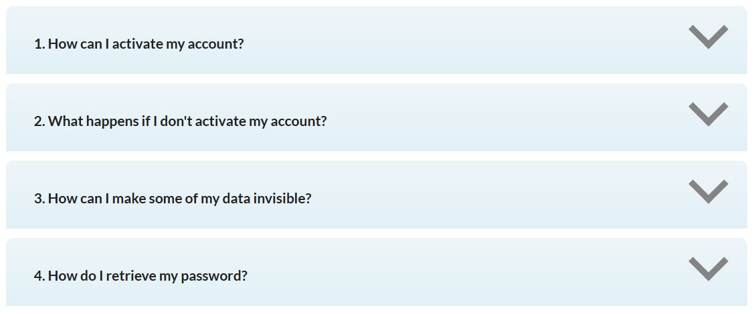
Firstly, We Listened!
Notes:
THIS AND SLIDE BEFORE = 90 seconds total TOPS IRENE

Slide 3

Case of
https://ernest.essec.edu/
“Our teammates from ESSEC have raised 65 tickets, combined, over 16 months”
Notes:
THIS AND SLIDE BEFORE = 90 seconds total TOPS IRENE

Slide 4
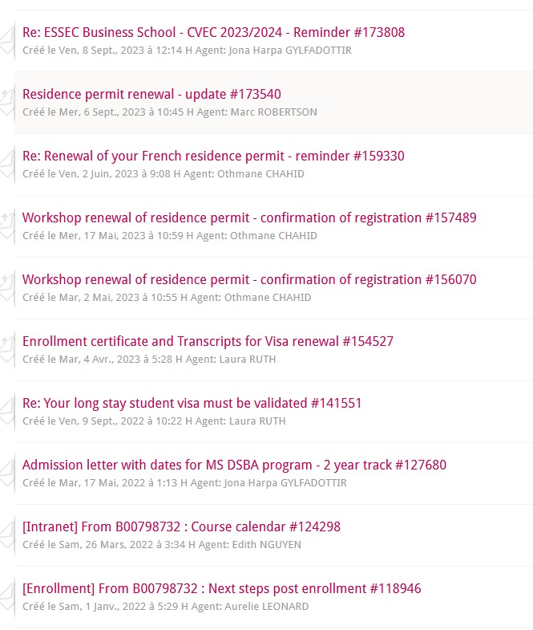
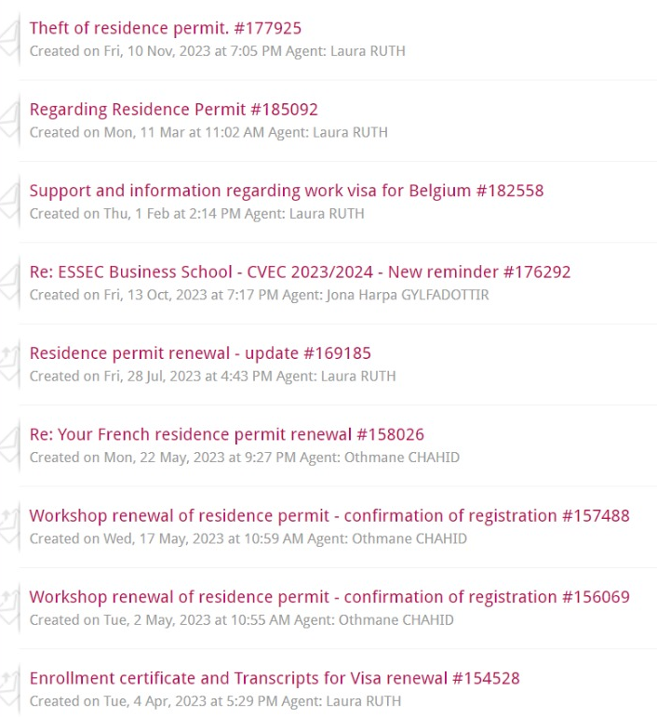
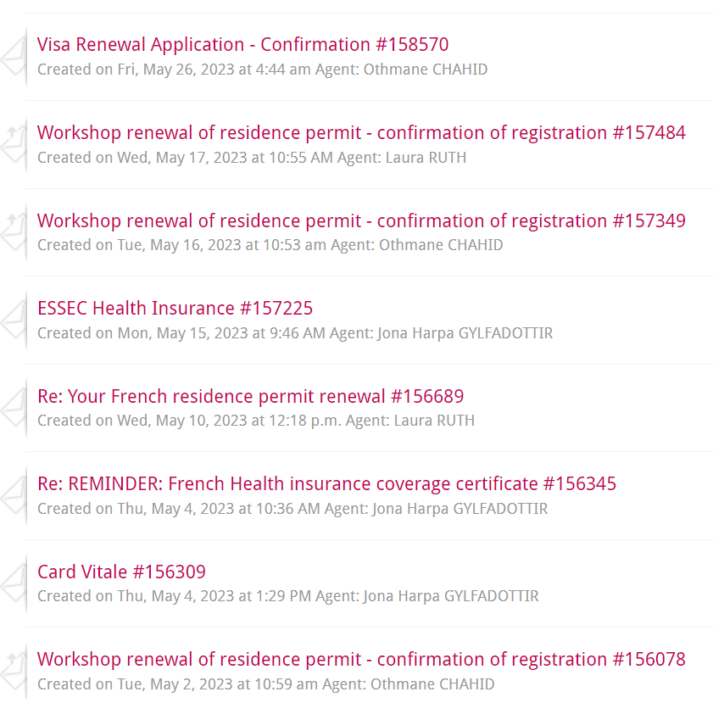
Student 1
Student 2
Student 3
Repeated Themes | Solutions Available in the Portal | No Enhancement Initiatives
Notes:
THIS AND SLIDE BEFORE = 90 seconds total TOPS IRENE

Slide 5
Problem In Hand
01
02
03
Overwhelming Information
The existing FAQ portal contained vast amount of information spread across numerous sections and articles.
Students struggle to find specific answers quickly, leading to frustration and inefficiency.
Poor Navigation and Search Functionality
Navigation is not intuitive, making it difficult for students to locate relevant sections.
search functionality is often ineffective as it is just keyword based.
Slow Response Time
Delayed response time from registrar that is problematic for students that need urgent assistance
SHORT TERM
Identify drivers of waiting times
based on historical values
Pinpoint areas of improvement
04
05
Repeated Questions and Lack of Analytics
Administrators face repeated questions, leading to redundancy and inefficiency.
No initiatives to analyze the themes of tickets, preventing improvements in information availability and accessibility.
Frustrating Experience
Lack of personalization and no real time assistance lead to a suboptimal user experience, deterring students from utilizing the portal effectively.
Wastage of involved stakeholders time
Thereby, enhance Port Aventura’s
visitor experience and satisfaction
Notes:
30 SECONDS JO

Slide 6
CampusBOLT
Speeding Up Campus Success
Our RAG + Mistral LLM based AI chatbot combines the strengths of retrieval-based and generative approaches to provide accurate and contextual responses to a user’s administrative concerns, in real time.
Use Cases
Instant Information Access
Real-Time Assistance for Urgent Queries
Multilingual Support for International Potential and Enrolled Students
Operational Efficiency For Administration
Notes:
1MIN 30 IRENE

Slide 7


“CampusBOLT Demo
Notes:
THIS + LAST SLIDE 2 MN MAX - TOTAL TIME = 10MN MAX JO

Slide 8



No hallucinations, just crisp answers
Reliable
Focused
Concise
The chatbot provides accurate and trustworthy information, drawing directly from the school's official documents and resources.
The responses are carefully curated to address the specific needs of the user, without any irrelevant or hallucinated content.
The chatbot delivers its responses in a clear and succinct manner, ensuring that students quickly find the information they need.

Slide 9



Exact source to the answers
Document Retrieval
Source Transparency
Enhanced Trust
By offering this level of transparency, the chatbot builds trust and confidence in the user, ensuring a positive and reliable experience.
The chatbot is designed to identify and retrieve the most relevant documents from the school's knowledge base to answer each query.
In addition to the response, the chatbot provides the exact source of the information, allowing students to easily verify the accuracy of the information.

Slide 10

Raise a ticket for human agent
Seamless Escalation
Personalized Attention
Continuous Improvement
If the chatbot is unable to provide a satisfactory answer, students can easily raise a support ticket to be handled by a human agent.
The ticket system ensures that each student's issue is addressed individually, with a dedicated agent providing the necessary assistance.
The feedback and insights gathered from the ticket system will be used to further enhance the chatbot's capabilities and knowledge base.

Slide 11
Implementation
Precise Matching with Similarity Search on Title and Content
Source Documents Quoted
Handling URLs in Answers
Conversational In Nature
Thought-Out Prompt Engineering
Multi-Lingual Support
Robust Backend Infrastructure
Scalable
Notes:
YIRU

Slide 12
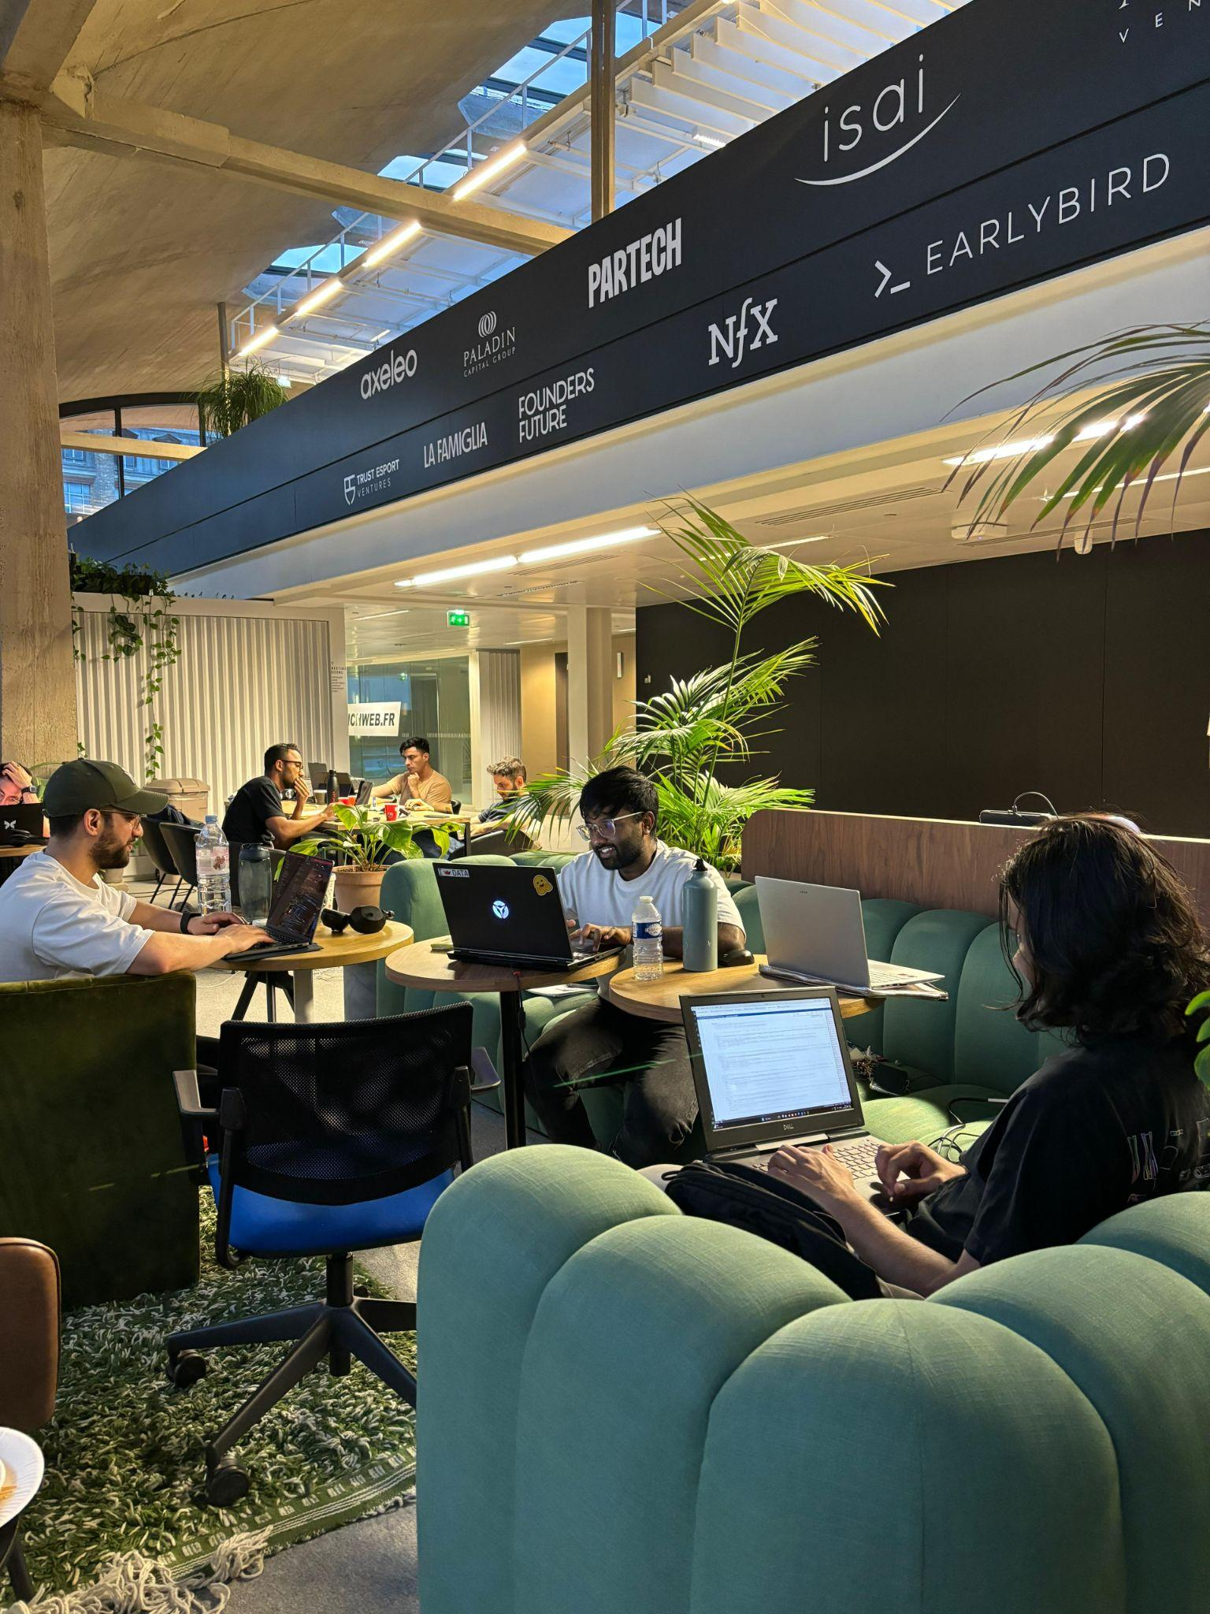
THANK YOU
QUESTIONS ?
Tribe PARI

